Slide 1
A#
2024.09.25~26 week04
Summary of System Concept

Slide 2
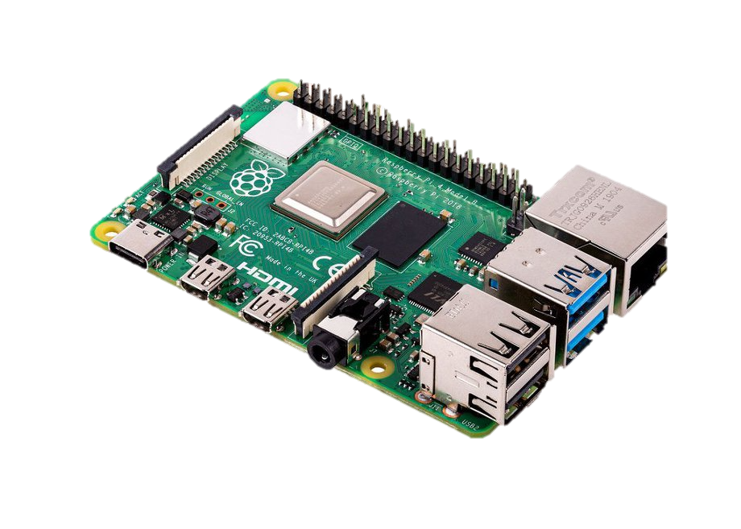
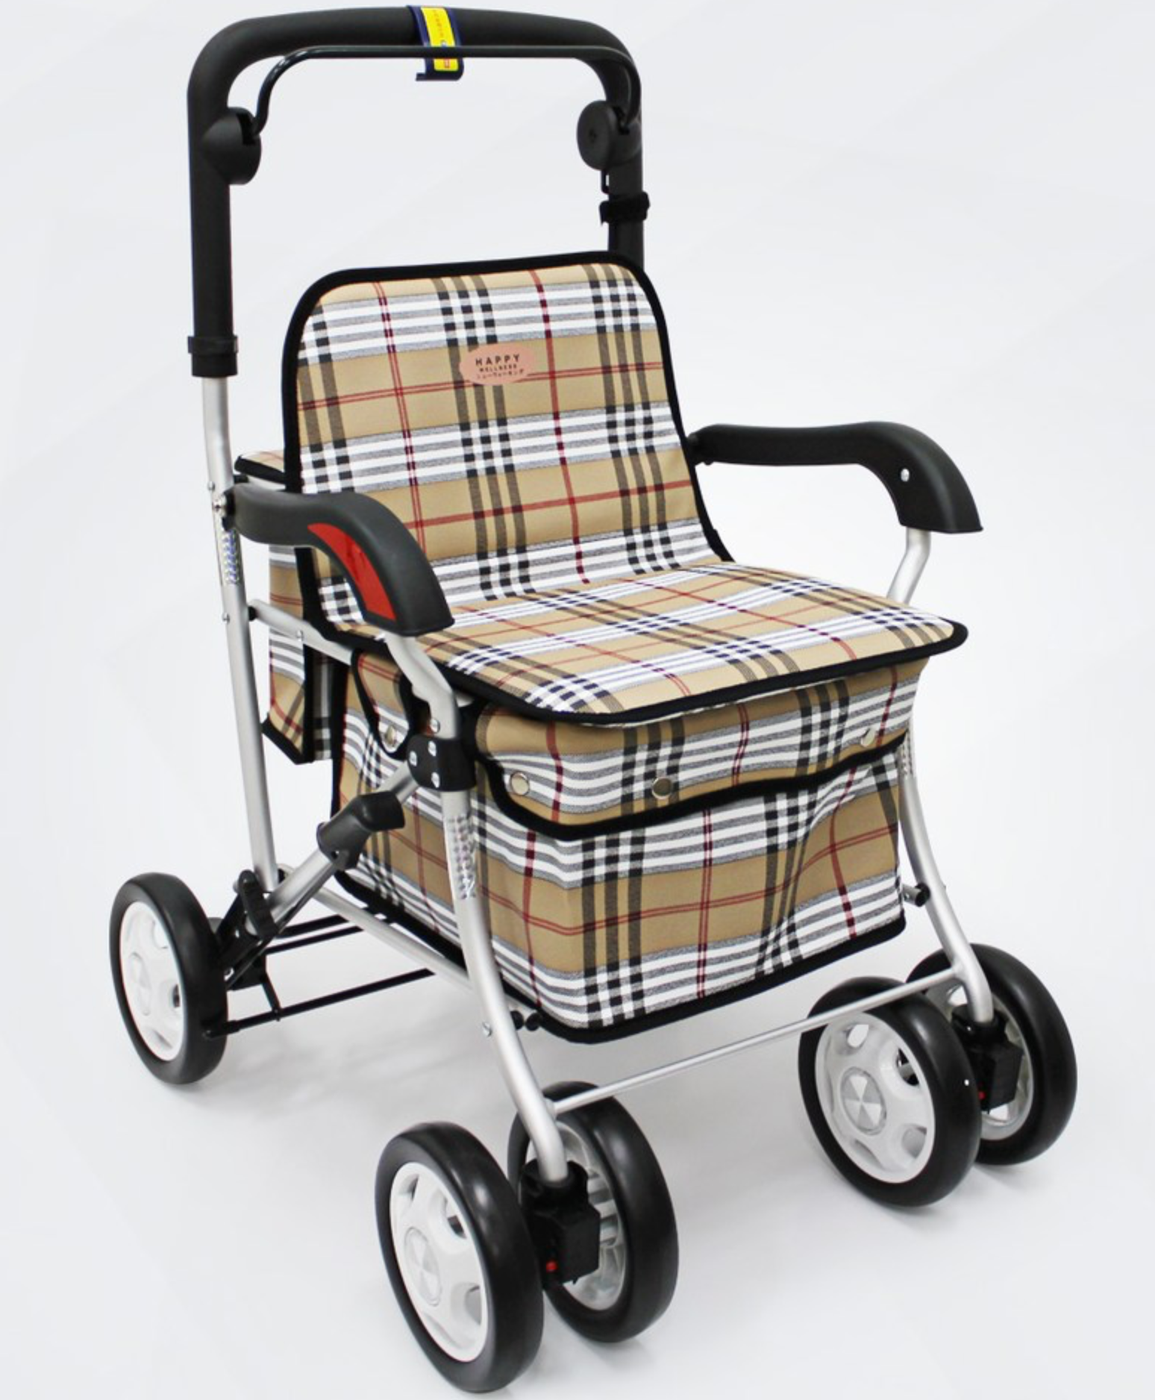
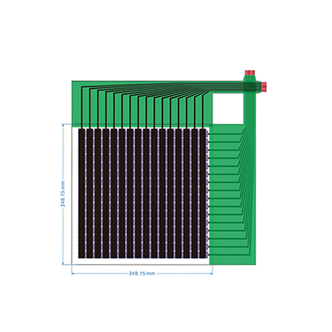
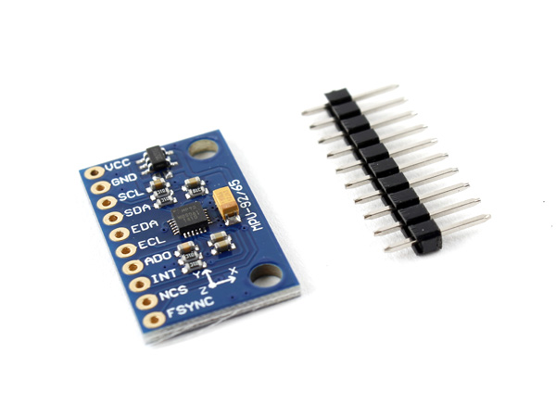
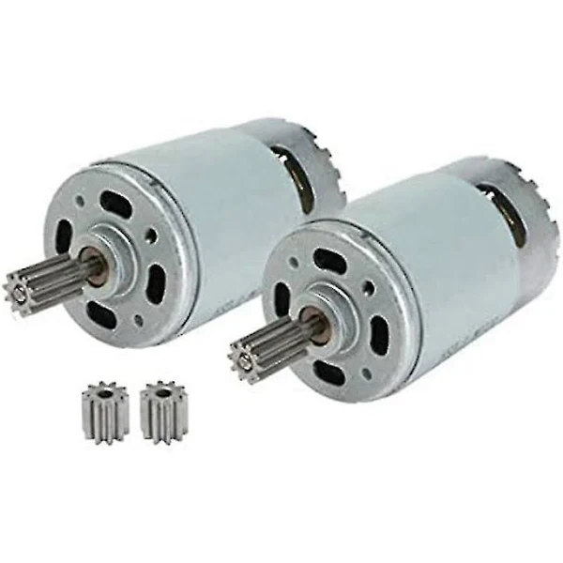
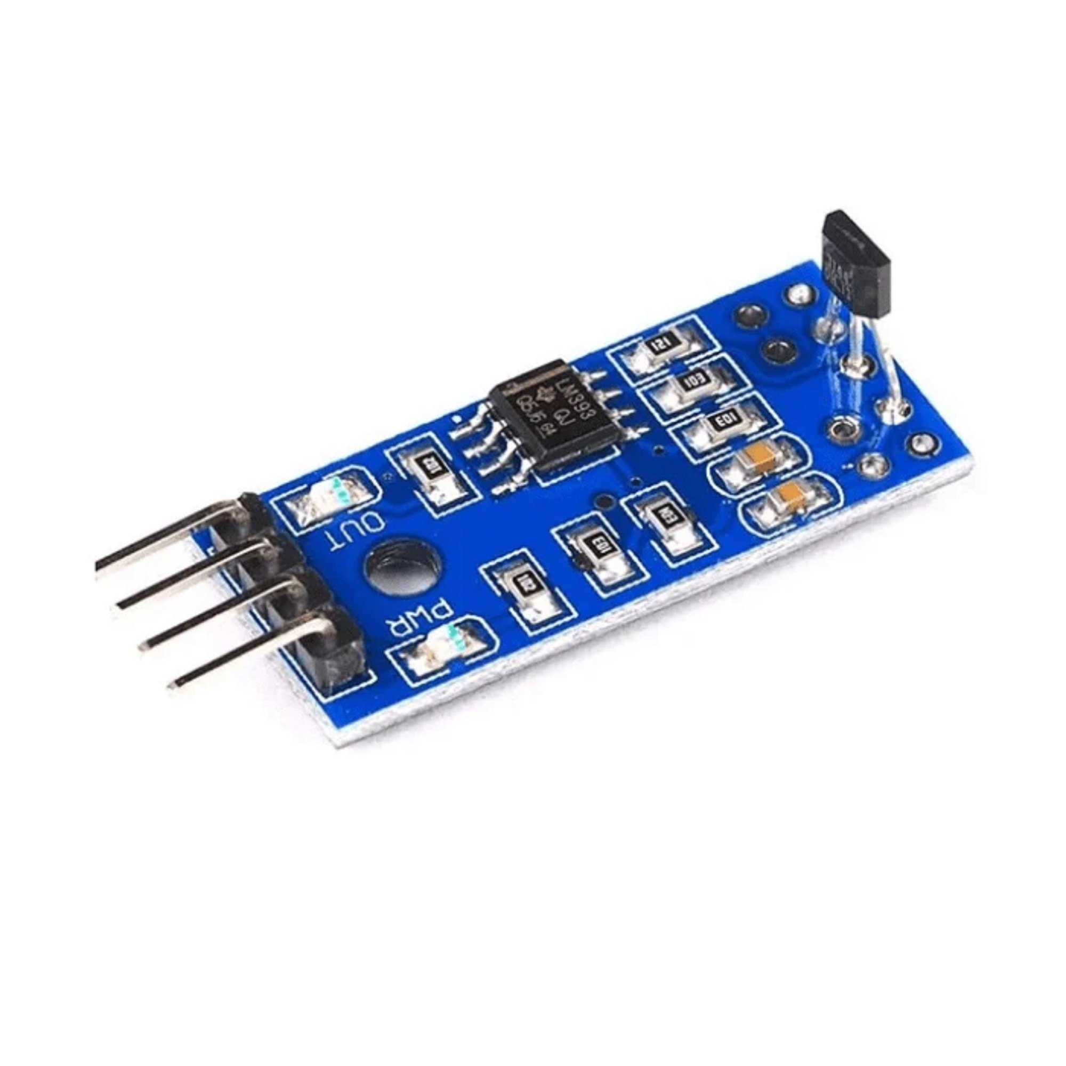
Sensors and Actuator in use
Pressure Mapping Sensor
Vision Processing
Gyroscope
Electric Motor
Hall Effect Sensor

Slide 3
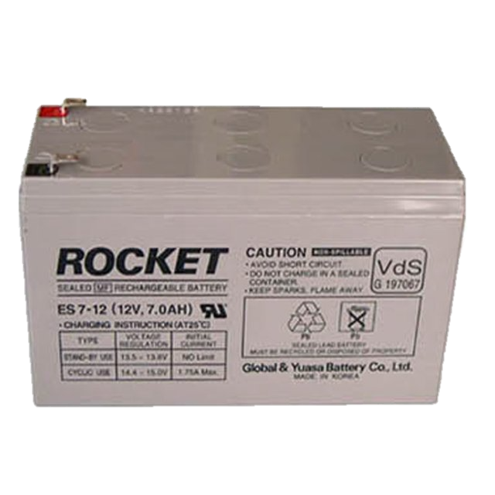
Powering - Battery
Over 12V, 10A
for Powering motor and Control Systems

Slide 4
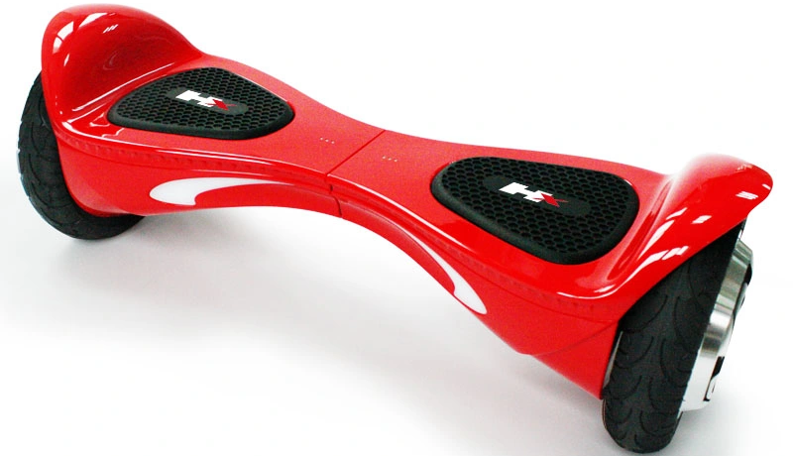
Actuator - Electric Motor

Slide 5

Sensor – Pressure Mapping Sensor
Pressure Mapping Sensor
FSR
Tekscan
Etc…

Slide 6
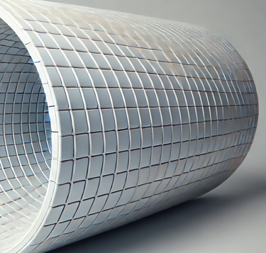
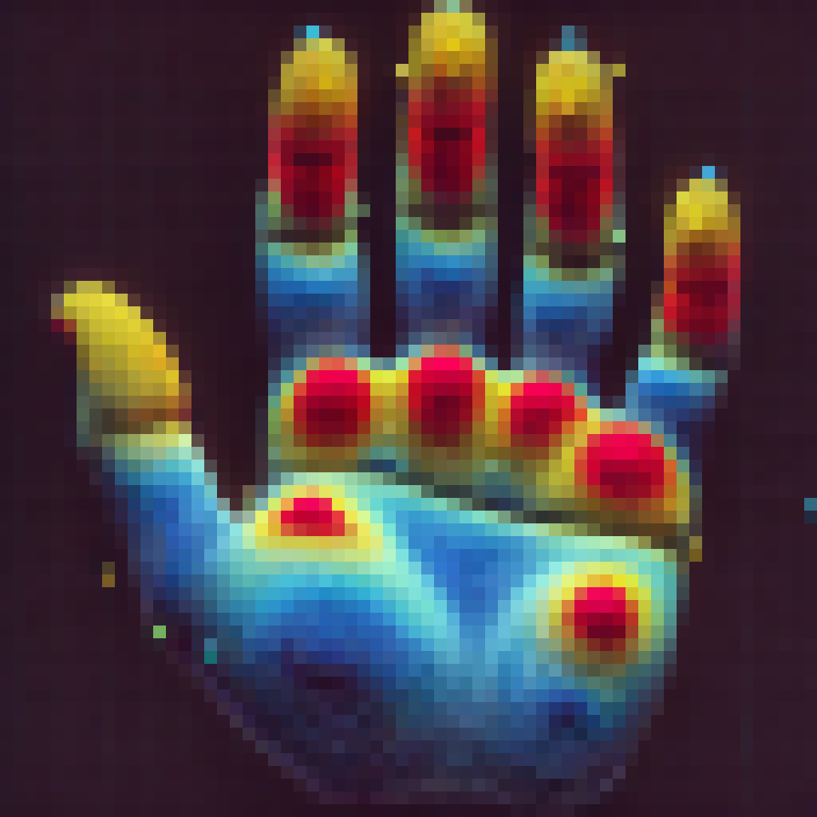
Handle Pressure Sensing

Slide 7
Sensor - Gyroscope
Gyroscope
BMI160
MPU-9250
Etc…
Speed Estimation
Vehicle Tilt Measurement

Slide 8
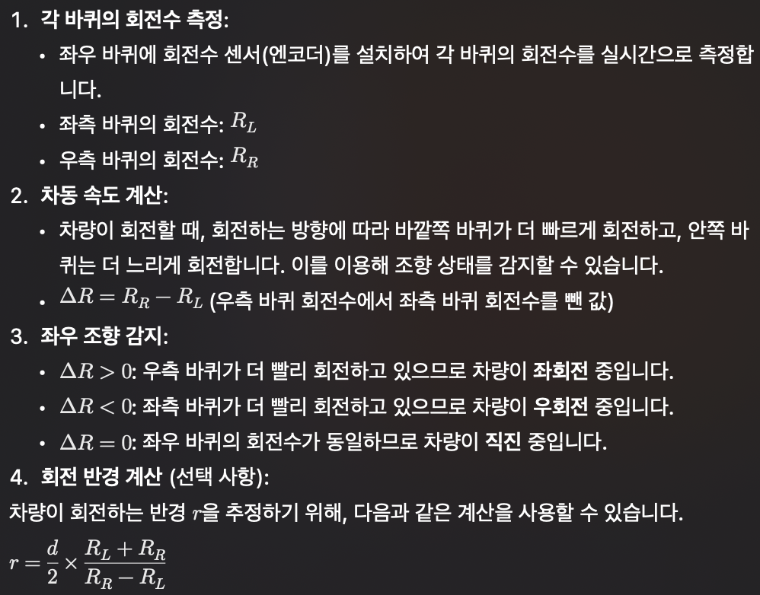
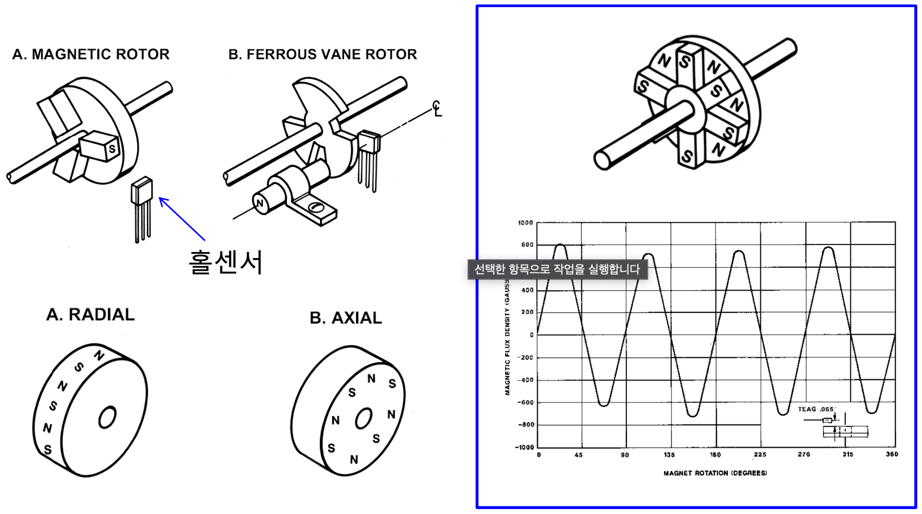
Sensor – Hall Effect Sensor

Slide 9
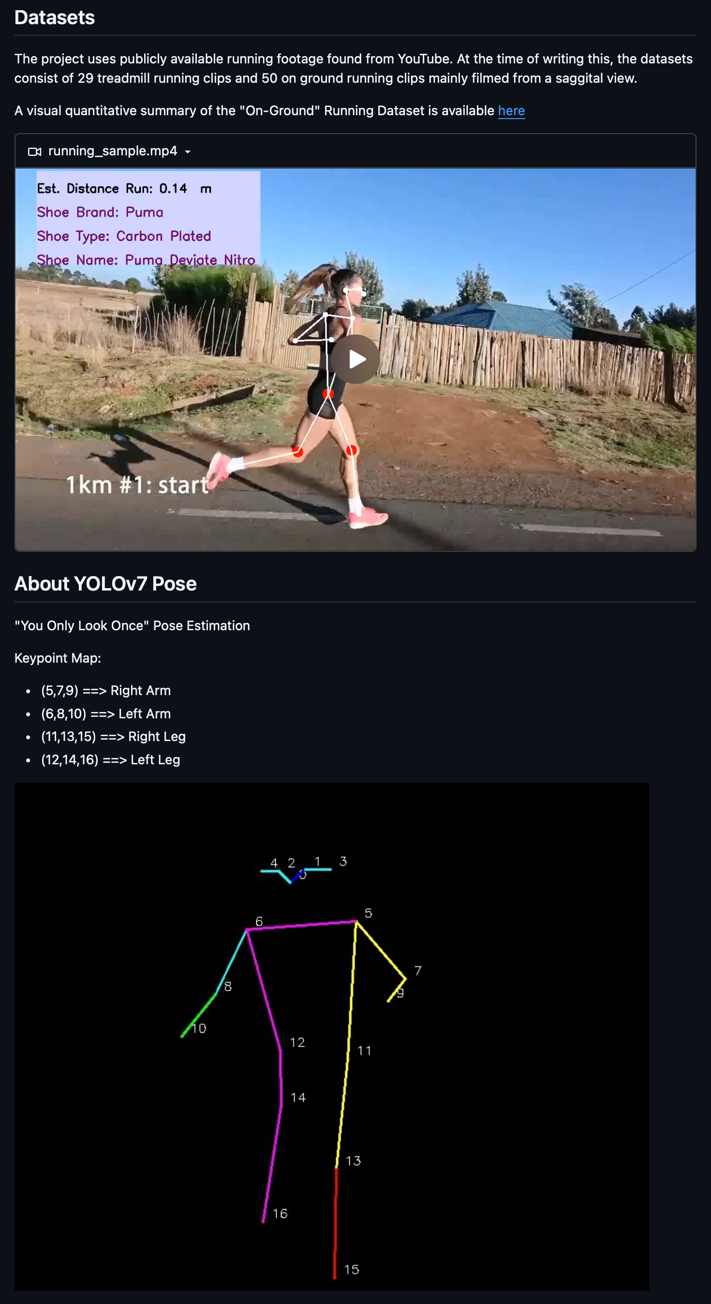
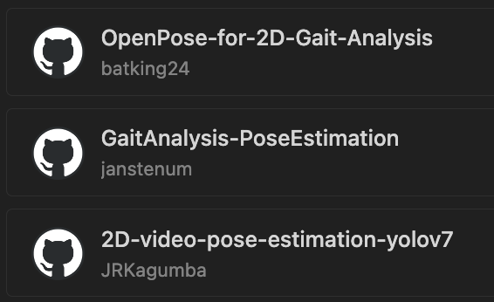
Video Processing

Slide 10
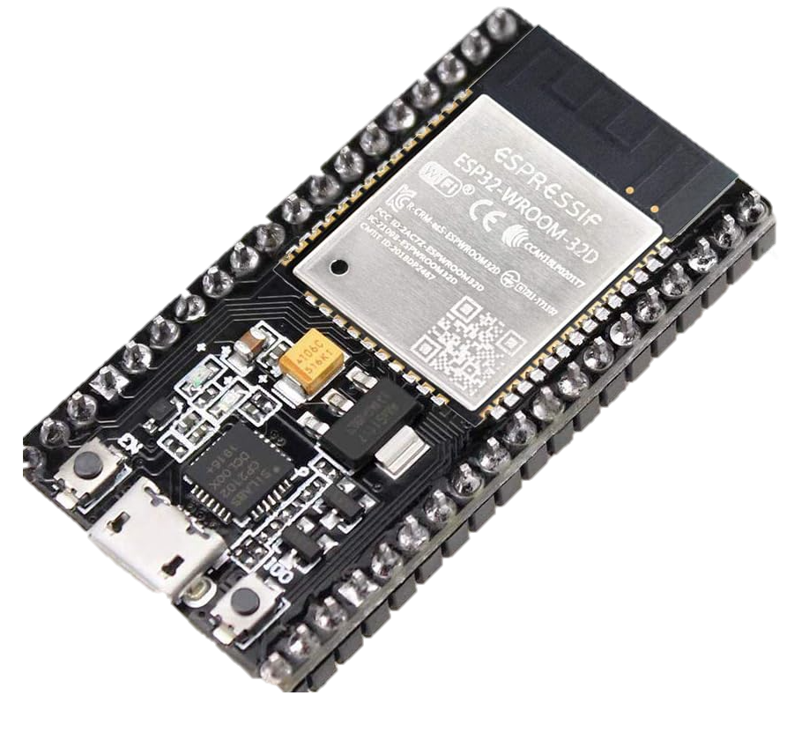
Separation of Control and Learning Unit
Wired Communication
Micro Controller
Sensing
Control
Raspberry Pi
Video Record
Video Processing

Slide 11
The Roles of the two Units
MCU
Video Processor
Sensing and Actuating
Weight-based neural network computation
Wired communication with the Video Processor
Power management of the Video Processor
Video Process
Video Record
Wired communication with the MCU
Modification of weights in the MCU
Video Processing while charging

Slide 12
Cold Start Problem
최초 구동 시 학습 데이터 부족으로 인한 정상 구동 이슈 발생
기존 사용 장치의 경우 충전 중 학습을 사용한 전원 이슈 관리
학습 데이터 부족과 관련하여 즉각 피드백 프로세스 필요

